Slide 1

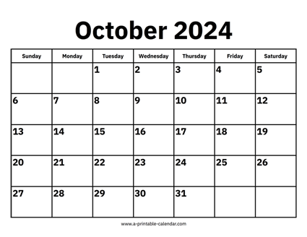

CS 310 : Scalable Software Architectures
Week 03 (Oct 07 – 11)
This week in CS 310:
Focus this week:
Web services
Class sessions *are* being recorded this week
Will be available under Panopto on Canvas
Project 01 due Wednesday Oct 9th @ 11:59pm
Building a simple client-server Photo app
Gradescope is open (unlimited submissions)
Can submit as late as Friday night
Office hours have started --- we have 20+ TAs
See link on Canvas for hours and locations

Slide 2
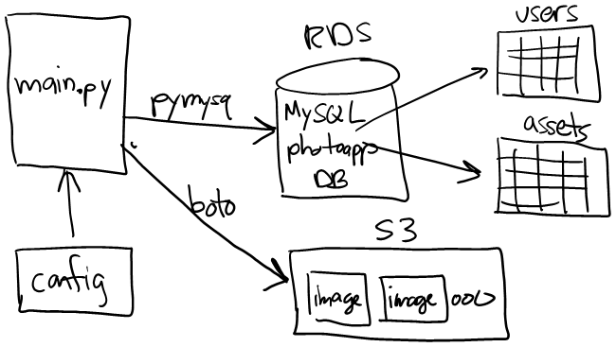
Project 01
Goals?
Start with a simpler, client-server architecture
Experience with AWS, DB, SQL and Python
Create infrastructure needed for future projects

Slide 3
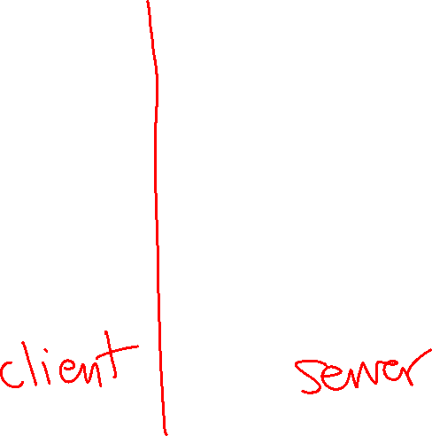
Project 01
Goals?
Start with a simpler, client-server architecture
Experience with AWS, DB, SQL and Python
Create infrastructure needed for future projects

Slide 4
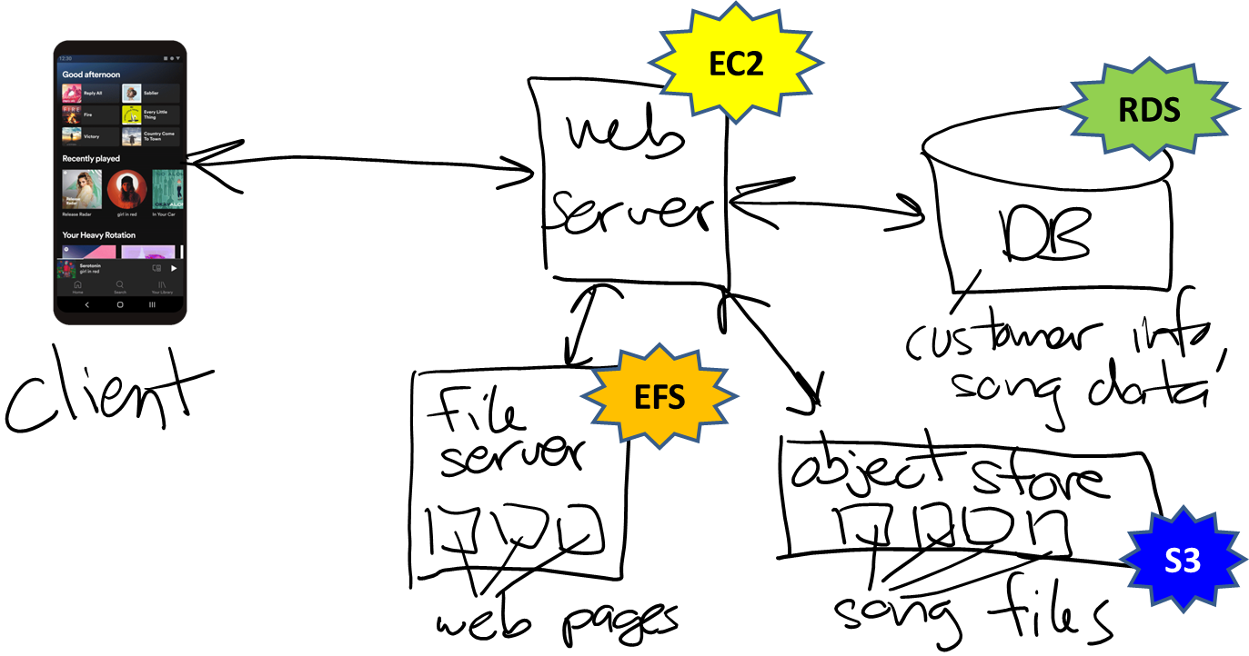
Multi-tier architecture
Recall that most software is multi-tier design…

Slide 5
Project 01 => Project 02

Slide 6
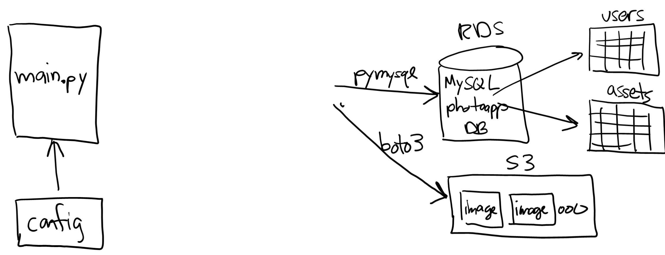






Project 01 => Project 02

Slide 7
Topics
Service-oriented architectures (SOA)
Web services
Building a web service using JavaScipt, Node.js and Express
Serialization and JSON
Examples and demos

Slide 8
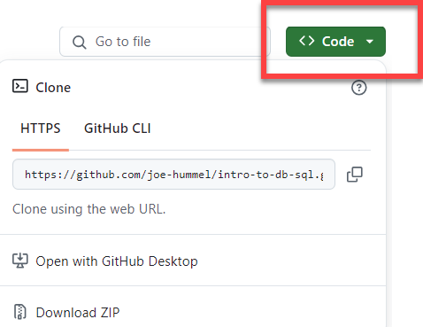
Class sessions
Summarize key points of lecture
Compare / contrast client-server vs. multi-tier
Build two web services: a simple calculator and a more realistic service for MovieLens database
Notes:
To work in class, make sure Docker Desktop is installed
Provided software uses Docker, download files from GitHub:
https://github.com/joe-hummel/intro-web-services
Clone repo or download ZIP

